Slide 1


EDA project: World Happiness Report-2024
Rabia Afzal

Slide 2


Outline:
Significance of world happiness report
Data features
EDA
Data Visualization

Slide 3
Significant data features:
Country name
(unique)
Regional Indicator
(10 regions)
GDP per capita
(log GDP per capita)
Happiness score
(range from 0 to 10, the best possible life being 10 and the worst possible life being a 0)
Social support
(national average of binary responses)
Healthy life expectancy
(average number of years for life expectancy at different ages)
Corruptions
(scale from 0 to 100, 0 highly corrupt and 100 very clean)
Freedom to make life choices
(national average of responses to the question about satisfaction with life choices freedom)
Dystopia + residual
(Dystopia imaginary least happy country + residual average value for each country should be positive, no country performs more poorly than dystopia )
Generosity
(national average of responses to the question about donating money to charity)

Slide 4
Significance of world happiness report
Measures the state of happiness in the world today.
Reflects a worldwide demand for more attention to happiness and well-being as criteria for government policy.
World happiness index is a tool for researchers, community organizers, and policy makers seeking to understand and enhance individual happiness, community well-being, social justice, economic equality, and environmental sustainability.
Based on the science of well-being using quantitative methods to know how different life experiences influence people’s happiness and quality of life.

Slide 5

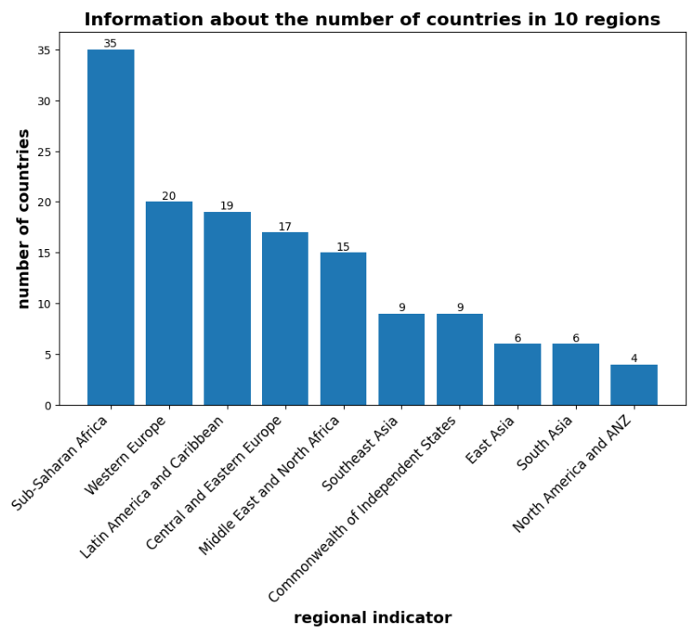
EDA:
Handled the missing values by deleting a few rows having almost null values (why I deleted them!)
Made the columns names in lower case and renamed them in shorter way.
Figured the number of unique countries out in 10 regions.

Slide 6
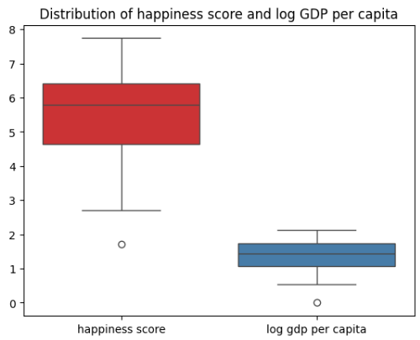
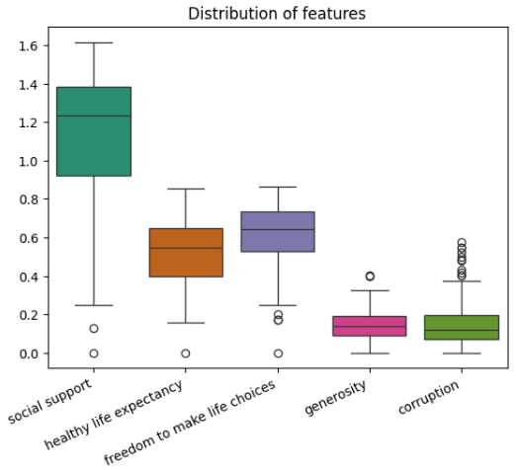
EDA: Detecting the outliers and statistical description of data features:
Analysis: Significantly noticed, some countries are much more unhappy than average as outlier is below the average in happiness score feature.
Analysis: In some countries, more contradictory data are recorded than general average. Data points are more condensed around the median for generosity and corruption as compared to others.

Slide 7
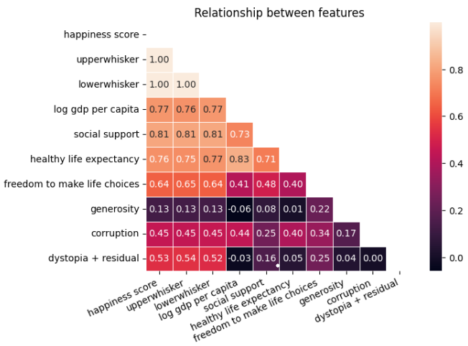
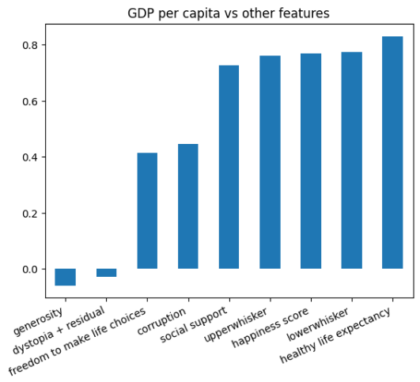
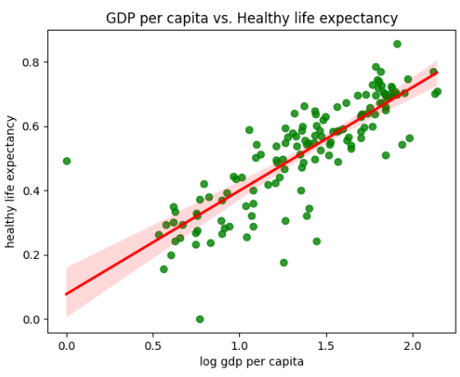
EDA: Relationship between features
Analysis: Happiness score is strongly positive correlated with social support with highest ratio value of 0.81, then it is linked with national income and then to health.
Analysis: Almost no relationship between national income and generosity that is donating money to charity on GDP per capita. In other words, both features are considered independent.
Analysis: GDP per capita is very strongly correlated with health ignoring a few outliers for a few countries. Both features are dependent. The higher the GDP, the healthier life we can expect in a country or region.

Slide 8
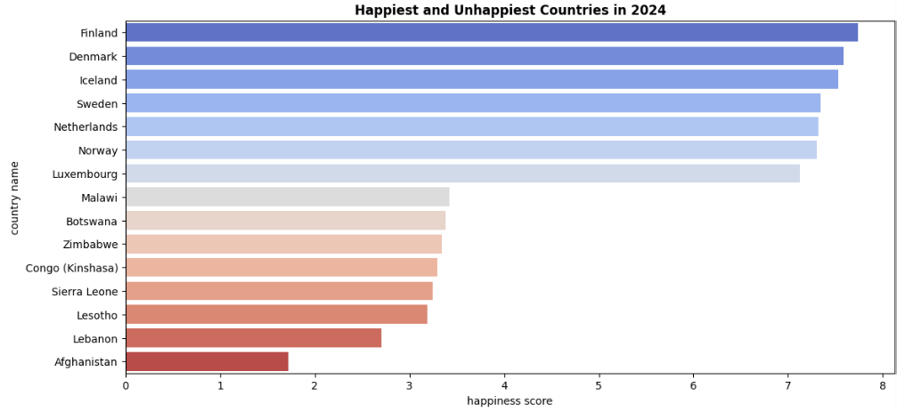
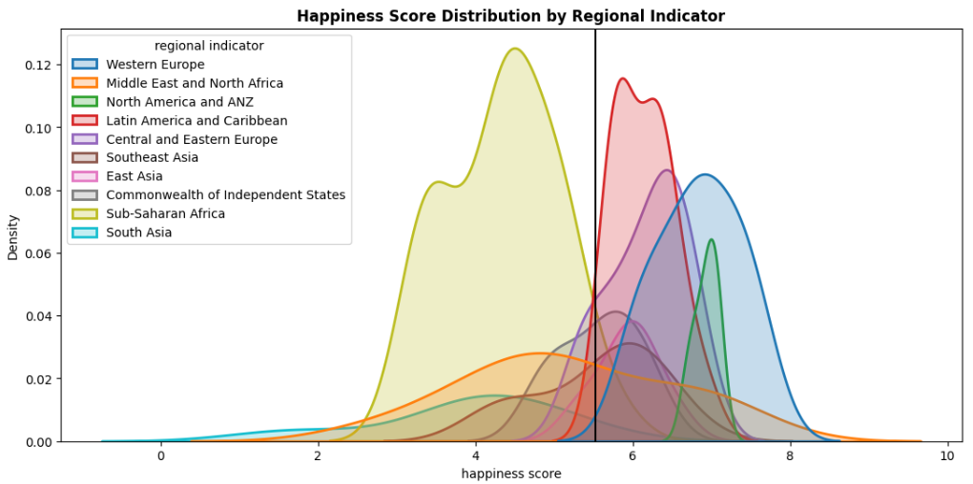
Happiest and Unhappiest places in the world:
Situation: Seek the happiest and unhappiest countries in the regions, and happiest score in the regions overall.
Task: Create a chart displaying the happiest and unhappiest countries and, also show happiness score distribution for regions in bottom plot.
Action: A chart was created displaying the happiest and unhappiest countries by setting the lower and upper limits in the graph of happiness score. We compared the happiness score on a region-by-region basis.
Result: Our analysis identified that Western European countries are happier than other countries. Also, happiness score is low in African region, South Asia and high in Western Europe.

Slide 9
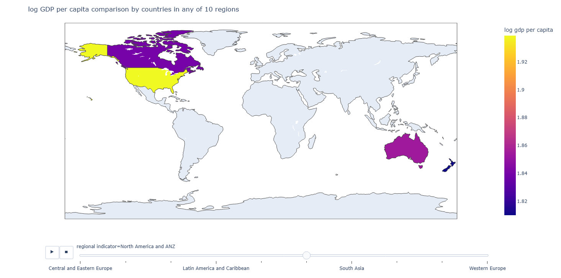
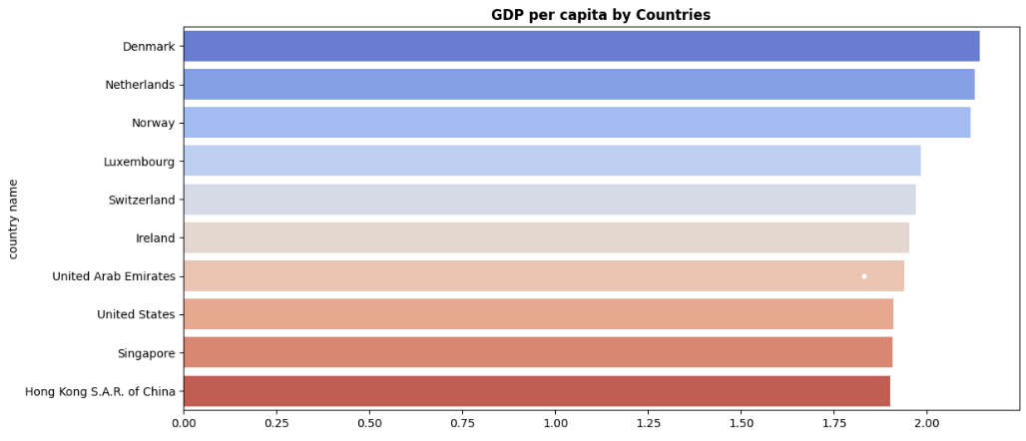
GDP per capita comparison by countries
Situation: Analysing the GDP per capita countries in the regions is vital for policy makers in government sectors.
Task: The goal was to create a map which would show GDP per capita by countries in 10 regions.
Action: We plotted a map displaying the countries with GDP per capita in any of 10 regions.
Result: Our visualization provides a significant easy way to visualize and compare the GDP per capita for countries in any of our 10 regions.

Slide 10
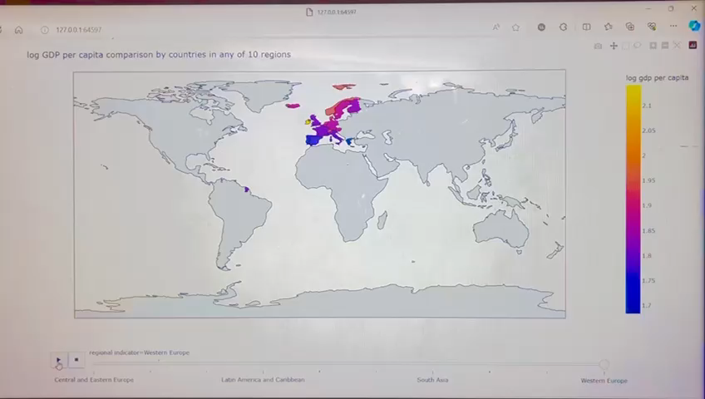
Log GDP per capita comparison by countries

Slide 11
Dashboard by countries and regions:
Situation: Analysing the corruption rate, generosity, life choices freedom and life expectancy score is important for community organizers, researchers, and migrants especially for their mental health.
Task: The goal was to create a dashboard which displays a comparison for countries and regions for the above features.
Action: We established a dashboard for visualizing the countries for generosity and life choices freedom over the regions, and, also visualizing life expectancy and corruption score for both, countries and regions.
Result: It provides a significant easy way for policy makers and migrants to visualize all above mentioned features for countries, and one feature, corruption for regions as well, to make their smart decisions.

Slide 12
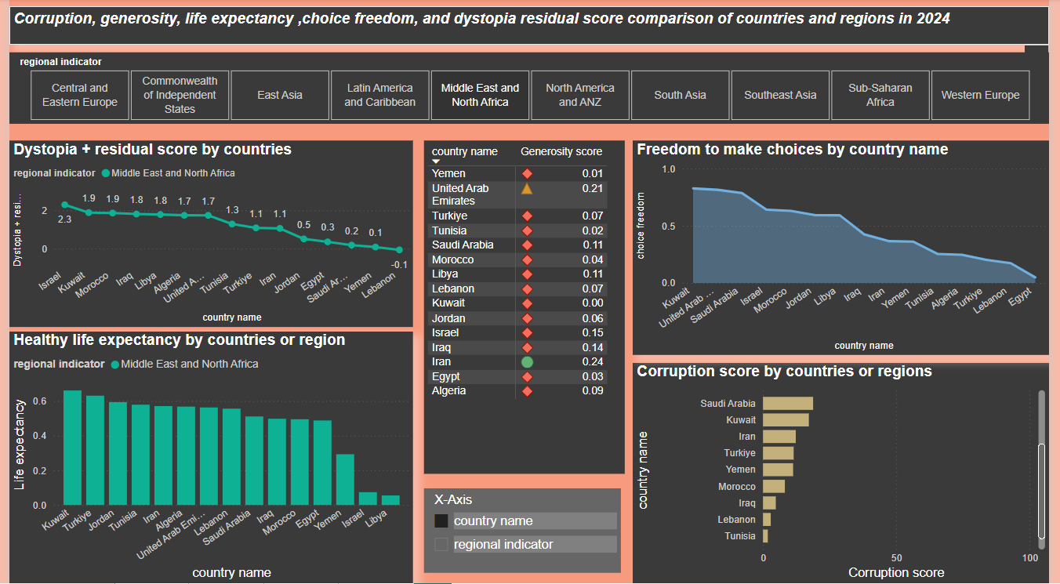
Dashboard by countries and regions:

Slide 13
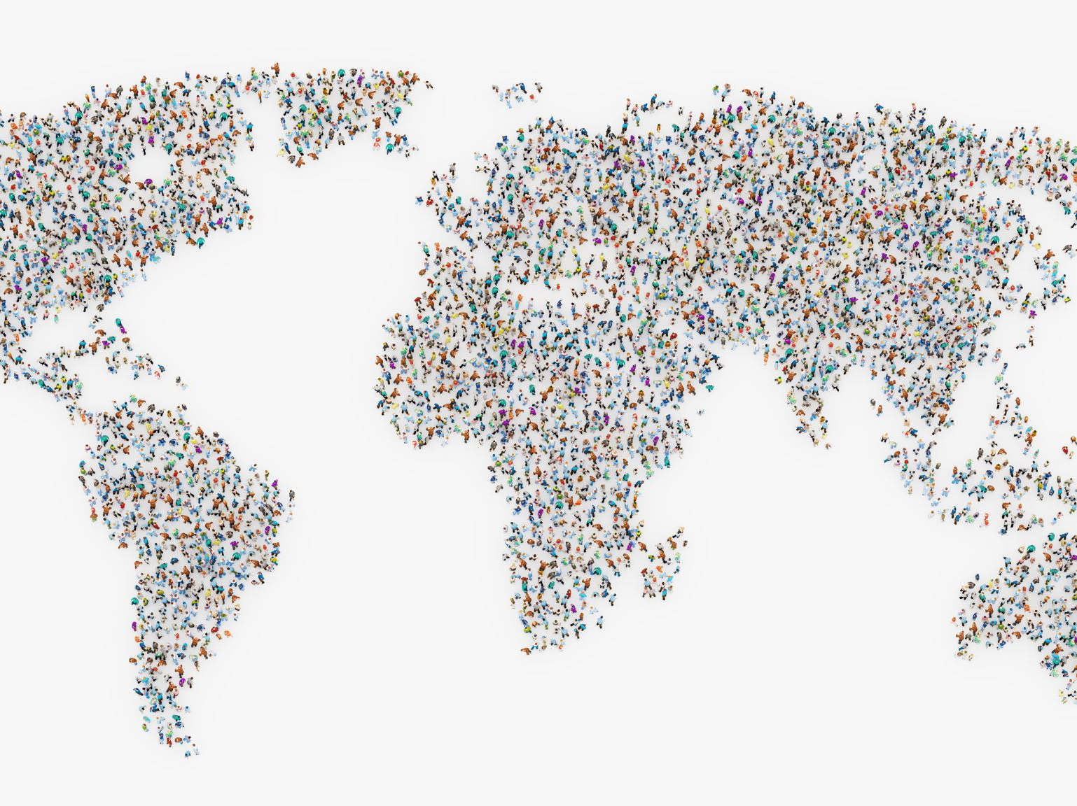
References:
World Happiness Report- 2024 (kaggle.com)
FAQ | The World Happiness Report
World Happiness Report | Gallup
World Happiness Report – Wikipedia
About | The World Happiness Report
Why Happiness Is Important – State of the Planet (columbia.edu)

Slide 14
Thanks for your attention

